Slide 1
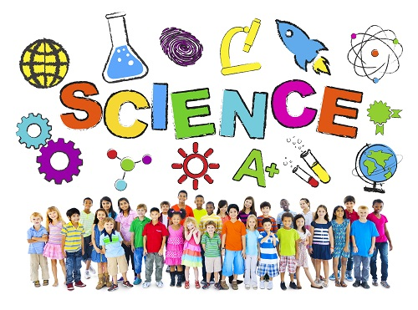
Sherry Li

Slide 2
What is Science?
The word “Science” means “knowledge” in Latin.

Slide 3
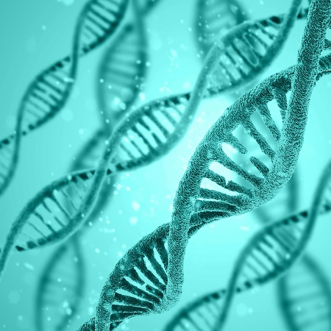
Science is:
A collection of knowledge that is used to explain the world around us.
A way of uncovering new pieces of knowledge

Slide 4
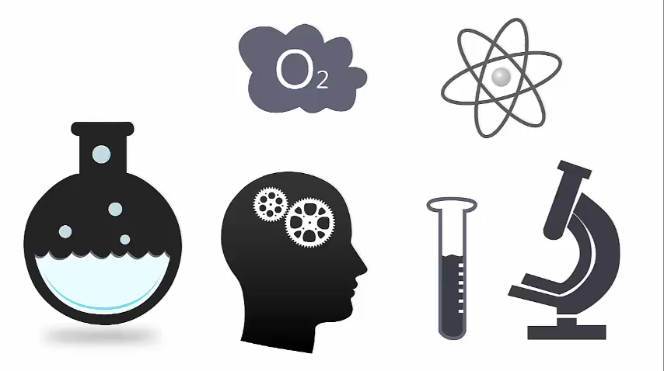
Science answers questions
?
Notes:
Science explains what is happening in the world around us. Science uses the scientific method to do this.

Slide 5
Ask a question
Do research
Construct hypothesis
Test hypothesis
Draw conclusion
Try Again
Hypothesis is proven
Notes:
Trying again is not a failure. When results disprove a hypothesis the scientist has gained new knowledge.

Slide 6
Fields of Science
Biology
Zoology
Microbiology
Medicine
Botany
Ecology
Paleontology
Chemistry
Organic chemistry
Electrochemistry
Inorganic chemistry
Physics
Particle physics
Mechanics
Wave theory
Astronomy
Thermodynamics
Optics
Electromagnetism
Meteorology

Slide 7
Disciplines Requiring Combined Knowledge
Discipline | Biology knowledge | Chemistry knowledge | Physics knowledge
Biochemistry | X | X
Genetics | X | X
Forensic Science | X | X | X
Geology | X | X | X
Nuclear Chemistry |  | X | X

Slide 8
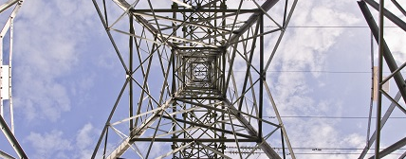
Applied Science

